Slide 1


IEEE International Conference on Collaboration and Internet Computing
(IEEE CIC 2015)
October 28 - October 30, 2015, Hangzhou, China
Analyzing Reliability in Hybrid Compute Units
Muhammad Candra, Hong-Linh Truong, Schahram Dustdar
Distributed Systems Group
TU Wien
Distributed Systems Group

Slide 2
Outline
Background
  Introduction to Hybrid Computing System
  Introduction to Reliability Analysis
  Motivation
Models
Reliability Analysis Framework
Implementation and Experiments
Conclusions and Future Works

Slide 3
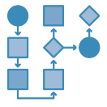





Hybrid Computing System
[Background]
Application
Software-based
services
Cloud-based services composition
Workflows with human-tasks
Crowdsourcing applications
IoT applications
Crowdsourcing platforms
Social networks of experts
On-premise experts
Human-based
Compute Units
Hybrid Compute Units
Quality Metrics?
RELIABILITY

Slide 4
Reliability Analysis
[Background]
What is reliability?
Why do we need?
  for designer
  for resource provider
  for task owner
How to measure?
The ability of a system to function correctly over a specified period of time, mostly under predefined conditions
SYSTEM IMPROVEMENTS
STOCHASTIC ANALYSIS

Slide 5
Reliability Analysis in HCS
[Background]
Problems for Reliability Analysis in HCS
  Non-continuous time space
  More ad-hoc inter-dependency
  Resources provisioning on The Cloud
Our goal:
To provide a set of tools for modeling and analyzing reliability for hybrid computing systems.

Slide 6
Motivating Scenario
[Background]
Infrastructure
Maintenance
Platform
Human-Based
Computing
Platform
HCU Collective
Resources pool

Slide 7
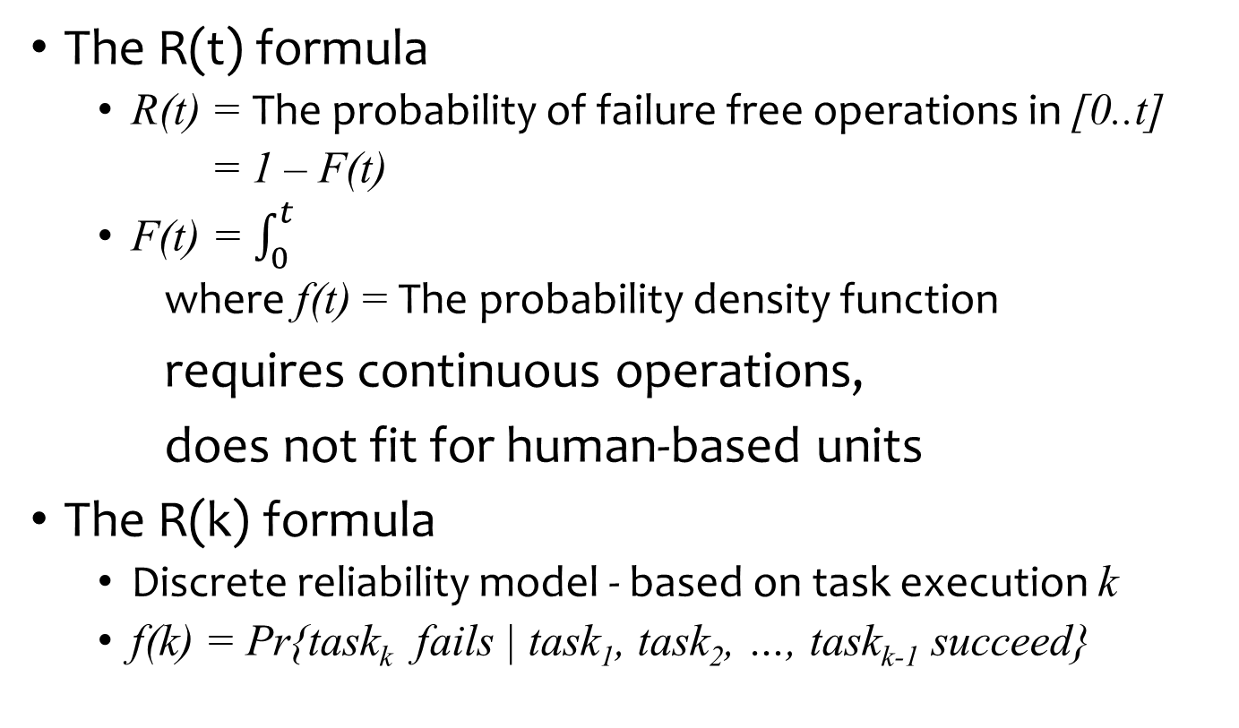
Reliability of Individual Units
[Models]
The R(t) formula
  R(t) = The probability of failure free operations in [0..t]
  = 1 – F(t)
  F(t) = $\int_{0}^{t}{}$
  where f(t) = The probability density function
requires continuous operations,
does not fit for human-based units
The R(k) formula
  Discrete reliability model - based on task execution k
  f(k) = Pr{task_{k} fails | task₁, task₂, …, task_{k-1} succeed}
f(τ)dτ

Slide 8
Collective Dependencies
[Models]
RA requires information on inter-dependencies between components.

Slide 9
System Overview
[Reliability Analysis Framework]
ASSIGNMENT
Static sets of resources
COMPOSITION
Resources discovered suitable for fulfilling a role
Virtual Standby Units (VSU)

Slide 10
Reliability Calculation (1)
[Reliability Analysis Framework]
Input:
  The individual reliability profile for each units
  Collective dependency
Outcome:
  The reliability for executing a set of K tasks.
Steps
  Obtain individual reliability on time t or on execution k
  Calculate the reliability for each role
  Calculate the reliability of the task executions
1
2
3

Slide 11
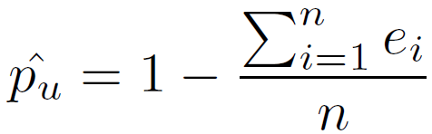
Reliability Calculation (2)
[Reliability Analysis Framework]
Obtain individual reliability
  (continuous) on time t (for machine-based units) or
  (discrete) on execution k (for human-based units)
  Domain-specific individual reliability model
For example (for human units), binomial distribution
  f(k) = (1 - p) ^{k-1} p
  R(k) = (1 - p) ^{k}
  How to get p?
1

Slide 12

Reliability Calculation (3)
[Reliability Analysis Framework]
Calculate the reliability for each role
  Reliability of statics set of unis
    Simplex
    Parallel / serial structure
    Static and dynamic redundancy
  Reliability of Virtual Standby Units (VSU)
    Similar to M-of-N redundancy
2

Slide 13
Reliability Calculation (4)
[Reliability Analysis Framework]
Calculate the reliability of the task executions
using Execution Spanning Tree (EST)
3
(VSU_{Se})
(SN)
(SAS)
(HCP)
(IMP)
ESTs:
IMP, SAS, VSU_{Se}, SN
IMP, HCP, VSU_{Cz}^{Coll}, VSU_{Cz}^{Asses}
IMP, HCP, VSU_{Cz}^{Coll}, VSU_{In}^{Asses}
IMP, HCP, VSU_{In}^{Coll}, VSU_{Cz}^{Asses}
IMP, HCP, VSU_{In}^{Coll}, VSU_{In}^{Asses}
(VSU_{Cz}^{Coll})
(VSU_{In}^{Coll})
(VSU_{Cz}^{Asses})
(VSU_{In}^{Asses})

Slide 14
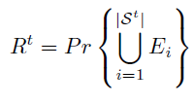
Reliability Calculation (5)
[Reliability Analysis Framework]
Calculate the reliability of the task executions
using Execution Spanning Tree (EST)
3
Given S^{t}, as a set of ESTs, e.g.:
IMP, SAS, VSU_{Se}, SN
IMP, HCP, VSU_{Cz}^{Coll}, VSU_{Cz}^{Asses}
IMP, HCP, VSU_{Cz}^{Coll}, VSU_{In}^{Asses}
IMP, HCP, VSU_{In}^{Coll}, VSU_{Cz}^{Asses}
IMP, HCP, VSU_{In}^{Coll}, VSU_{In}^{Asses}

Slide 15
Prototype Implementation
[Implementation & Experiments]
Runtime and Analytics for Hybrid Computing Systems (RAHYMS)
  Based on GridSim toolkit
  Features
    Simulate a pool of resources (machine-based and human-based units)
    Simulate task requests generation
    Strategies for HCU formation
    Reliability analysis tool

Slide 16
Experiment Setup
[Implementation & Experiments]
Focus on VSUs
  Sensors
    R(t) = e^{-λt}
  Human: Citizens and Inspectors
    R(k) = (1 - p)^{k}
    t = k / 30
Assumed static:
  Infrastructure Management Platform (IMP)
  Human-based Computing Platform (HCP)
  Sensors Network (SN)

Slide 17
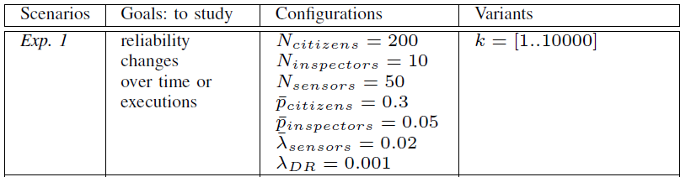
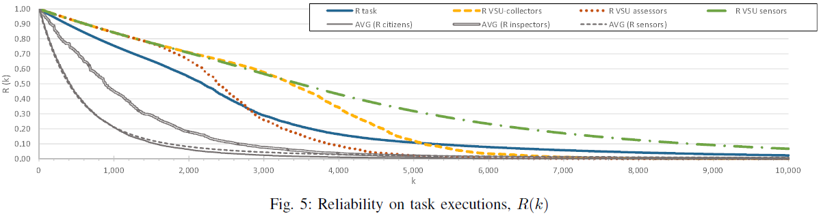
Experiment 1
[Implementation & Experiments]

Slide 18
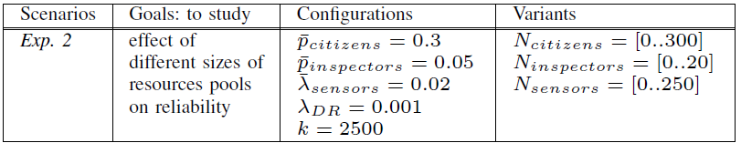
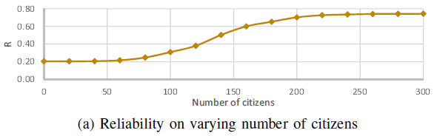
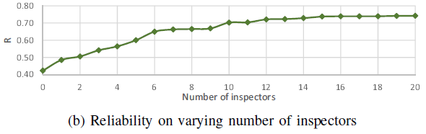
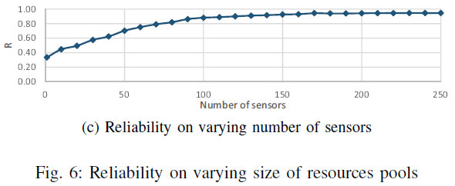
Experiment 2
[Implementation & Experiments]

Slide 19
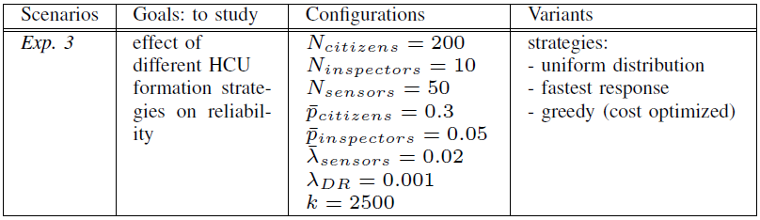
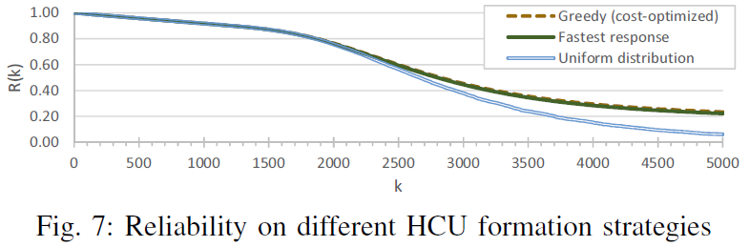
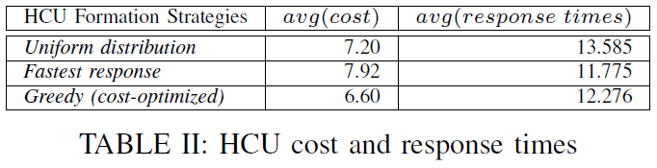
Experiment 3
[Implementation & Experiments]

Slide 20
Conclusion
[Conclusions & Future Works]
Models
Individual Reliability
(Continuous & Discrete)
Collective Dependency
(Collaboration for known structure)
Framework
Tools for Reliability Analysis
Experiments show how the RA can be used to obtain insights for system improvements.
Future Works
Dependable hybrid human-machine computing
Dependability metrics: availability, performance, quality of results.

Slide 21
Thank you
Acknowledgments
The first author of this paper is financially supported by Vienna PhD School of Informatics http://www.informatik.tuwien.ac.at/teaching/phdschool
The work mentioned in this paper is partially supported by EU FP7 FET SmartSociety project http://www.smart-society-project.eu/

